Slide 1




Addressing a Crisis:
Cross-Sector Strategies to Prevent
Adolescent Substance Use and Suicide

Slide 2
Trust for America’s Health (TFAH) is a nonprofit, nonpartisan public health policy, research and advocacy organization that promotes optimal health for every person and community and makes the prevention of illness and injury a national priority.
Well Being Trust (WBT) is a national foundation dedicated to advancing the mental, social and spiritual health of the nation. Created to include participation from organizations across sectors and perspectives, Well Being Trust is committed to innovating and addressing the most critical mental health challenges facing America and to transforming individual and community well-being.

Slide 3
The good news…
Progress has been made in reducing some risky behaviors.
Positive trends in adolescent substance misuse and related risk factors underscore the value of prevention efforts and policies.

Slide 4
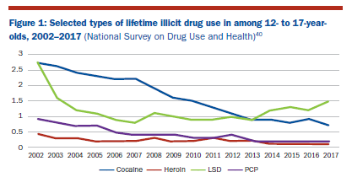
Use of illicit or injection and prescription drugs among adolescents has declined or held steady.
Students in 8th, 10th and 12th grades have experienced a decline in past-year illicit drug use from 16 percent in 2001 to 9 percent in 2018
The percentage of high school seniors who believe opioids are easily accessible declined from 54 percent in 2010 to 36 percent in 2017

Slide 5
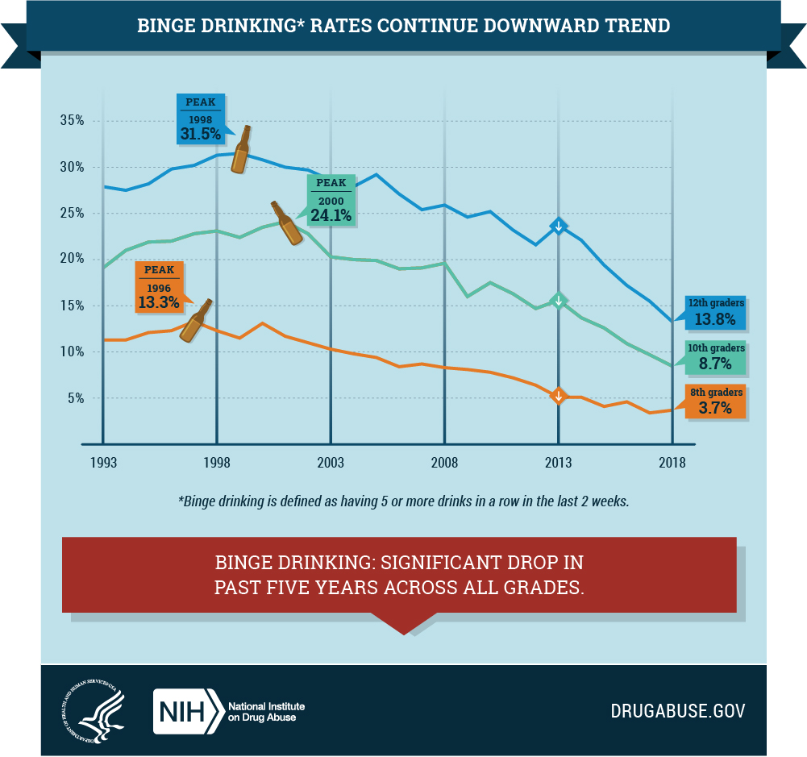
Alcohol use among adolescents has declined significantly over the past decades.
Lifetime alcohol use among high schoolers has declined from 82 percent in 1991 to 10 percent in 2017
Among 8th, 10th and 12th graders, daily alcohol use is down by three-fourths and past-month use is down by one half
Drunkenness and binge drinking among this age group have also declined

Slide 6
The bad news…
Adolescent suicide deaths have spiked over the last decade and substance misuse is exacting a heavy toll on teens.
While progress has been made in reducing some risky behaviors, adolescent suicide and substance misuse rates remain high and in some cases are climbing.

Slide 7
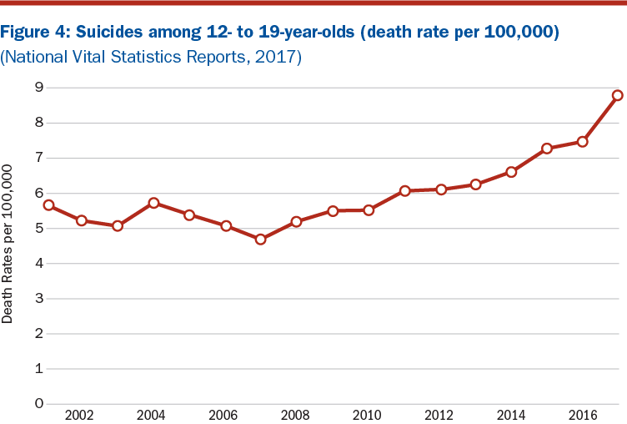
Suicide is the second leading cause of death among adolescents and is on the rise.
Suicide rates among 12- to 19-year-olds have increased 87 percent between 2007 and 2017
In 2017, 7.4 percent of high schoolers nationwide attempted suicide nationwide – a 17 percent increase from the previous year
Nearly 3,000 12- to 19-year-olds died by suicide in 2017

Slide 8
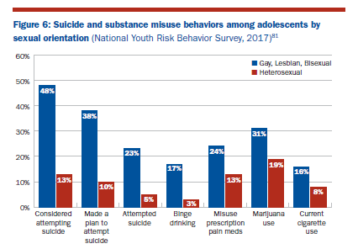
Data reveal staggering disparities in substance misuse and suicide rates.
48 percent of gay, lesbian and bisexual adolescents report considering or attempting suicide as compared to 13 percent of their heterosexual peers
Binge drinking is five times greater among gay, lesbian and bisexual high school students compared with heterosexual students

Slide 9
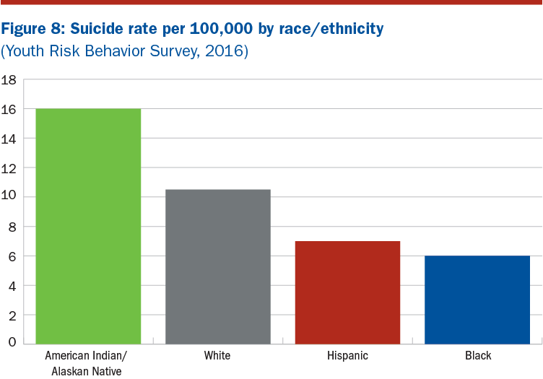
Data reveal staggering disparities in substance misuse and suicide rates.
American Indian/Alaskan Native teens experience the highest rates of suicide among any race and ethnicity in the United States
16 suicides per 100,000 15- to 19-year-olds in 2016
60 percent higher than the national average for all teens

Slide 10
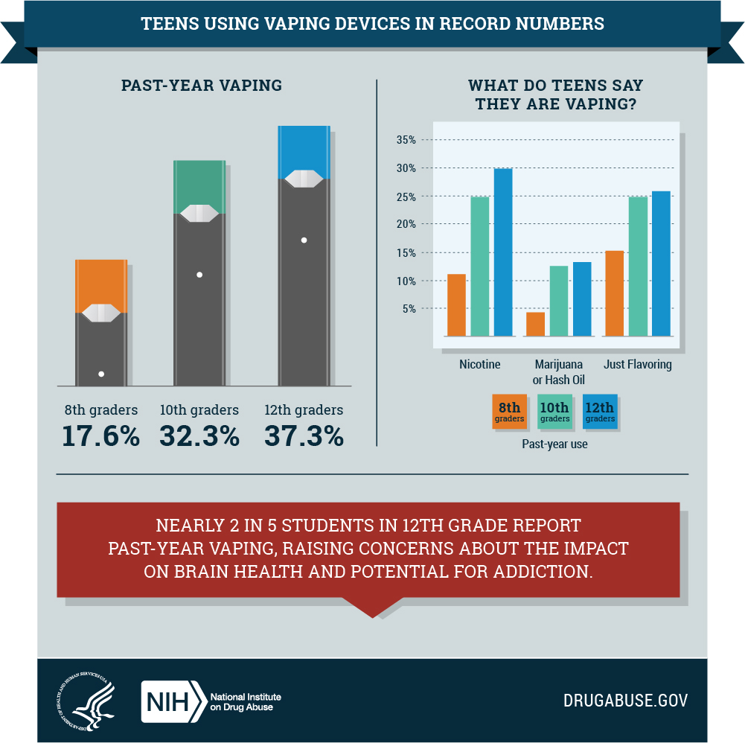
Rates of vaping among adolescents are climbing dramatically.
From 2017 to 2018 e-cigarette use by high school students increased by 78 percent
E-cigarette use increased by 48 percent among middle school students
More teens also report vaping marijuana

Slide 11
Addressing the problem…
Expansion of evidence-based, cross-sector strategies is necessary in order to save lives.
We can prevent substance use before it starts and promote mental health before problems develop.

Slide 12
In addition to the social determinants of health, there are risk and protective factors that can influence adolescent outcomes.
Risk factors increase an adolescent’s chance of experiencing negative outcomes and include things such as:
Abusive family relationships;
Poor parenting behaviors;
Academic failure; or
Attitudes, community norms or laws that are favorable to risky behaviors.
Protective factors serve as a buffer, reducing an adolescent’s chance of experiencing negative outcomes and include things such as:
Positive parenting;
Opportunities for positive social involvement;
Social and emotional competence; or
Positive self-image and belief in oneself.

Slide 13
Understanding the overlap between these cross-sector factors and conditions is crucial.

Slide 14
What Works…
Reducing adolescent substance misuse, suicide and other negative outcomes will require an integrated, multi-sector approach grounded in prevention.

Slide 15
Cross-Sector Strategies
Building social and emotional skills
Promoting connectedness and providing social support
Engaging youth voice
Addressing and reducing trauma, adverse childhood experiences and discrimination
Supporting the comprehensive needs of students and families
Mental and behavioral health services and supports
Promoting family-centered and community prevention models
Building multi-sector partnerships to address the factors that impact health

Slide 16
Building Social and Emotional Skills
Examples:
Social and Emotional Learning Programs
Positive Behavioral Interventions and Support
LifeSkills Training

Slide 17
Promoting Connectedness and Providing Social Support
Examples:
Promoting a Positive School Climate
Adult Mentorship
Strengthening Families Program
Gay-Straight Alliances

Slide 18
Engaging Youth Voice
Examples:
Youth-Led Participatory Action Research
Youth Input into Programs
Civic Engagement

Slide 19
Addressing and Reducing Trauma, Adverse Childhood Experiences and Discrimination
Examples:
Professional Training for Child-Serving Professionals (trauma-informed, cultural competence)
Youth Mental Health First Aid

Slide 20
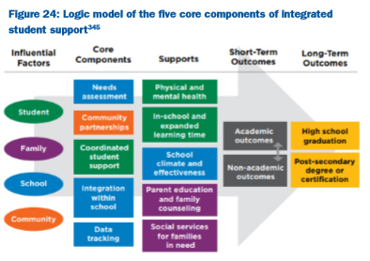
Supporting the Comprehensive Needs of Students and Families
Examples:
Earned Income Tax Credit, Food Assistance and Housing Subsidies
Integrated Student Supports (Communities in Schools)
CDC’s STRYVE
Notes:
Striving to Reduce Youth Violence Everywhere (STRYVE) is a national initiative led by the Division of Violence Prevention at CDC’s National Center for Injury Prevention and Control. STRYVE helps public health departments implement multisector, prevention-oriented approaches to reduce youth violence.353 Health departments develop comprehensive strategies to reduce violence and work with other sectors to implement evidence-based programs that:
l Strengthen the capacity of youth to prevent violence by building their skills and capacities and engaging them in positive youth-development programs to foster protective factors (e.g., healthy connections, confidence, competence, and contributions to the community);
l Build and maintain positive relationships between youth and the adults in their lives (parents, caregivers, teachers, and others) by strengthening the skills of the adults to better communicate, set and enforce rules, and monitor the child’s activities and relationships; by providing professional development to teachers about effective classroom management practices, conflict resolution, and positive connections with children from
diverse backgrounds; and by mentoring programs and activities that help youth build relationships with pro-social peers, rather than peers who have a negative influence;
l Promote economic opportunities and infrastructure in communities by, for example, developing business improvement districts, providing job skill training, or offering incentives for businesses to draw upon the local workforce;
l Promote connections among community members and organizations by creating regular and meaningful opportunities for all residents to interact;
l Promote community and school physical environments that promote safety and connectedness by addressing environmental factors such as lighting, availability of green space, and repair and upkeep of schools;
l Strengthen community policies that promote health and safety, such as policies that reduce the density of alcohol outlets;
l Foster social connectedness and a positive learning and working environment in schools;
l Promote societal norms about the unacceptability of youth violence by promoting a positive portrayal of youth as responsible members of society in the media and minimizing youth exposure to violence in media; and
l Address the social, economic, and structural conditions that affect youth violence and lead to health inequity by, for example, supporting mental health supports for young people and families or changing housing policy to deconcentrate poverty.

Slide 21
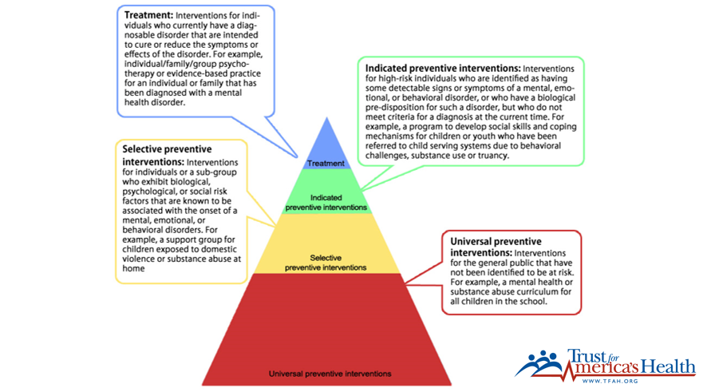
Mental and Behavioral Health Services and Supports
Examples:
Classroom Management
Increasing Medicaid Services in Schools
Screening, Brief Intervention and Referral to Treatment (SBIRT)

Slide 22
Promoting Family-Centered and Community Prevention Models
Examples:
Family-Centered Treatment
Zero Suicide Initiative
Garrett Lee Smith Memorial Suicide Prevention Program
Communities that Care

Slide 23

Building Multi-Sector Partnerships to Address the Factors that Impact Health
Examples:
Multi-sector Coalitions
Fostering Community Agency and Power
Policy, Systems and Environmental Changes

Slide 24
Policy Recommendations…
These conditions and risk and protective factors do not occur in siloes.
Policy action must be multi-tiered and multi-sectored.

Slide 25
Five Priority Areas:
Support and Nurture Families
Promote Positive Pathways to Educational and Life Success
Create Community Environments that Promote Mental and Physical Health
Build Infrastructure to Align Work Across Sectors
Increase Funding for Prevention

Slide 26
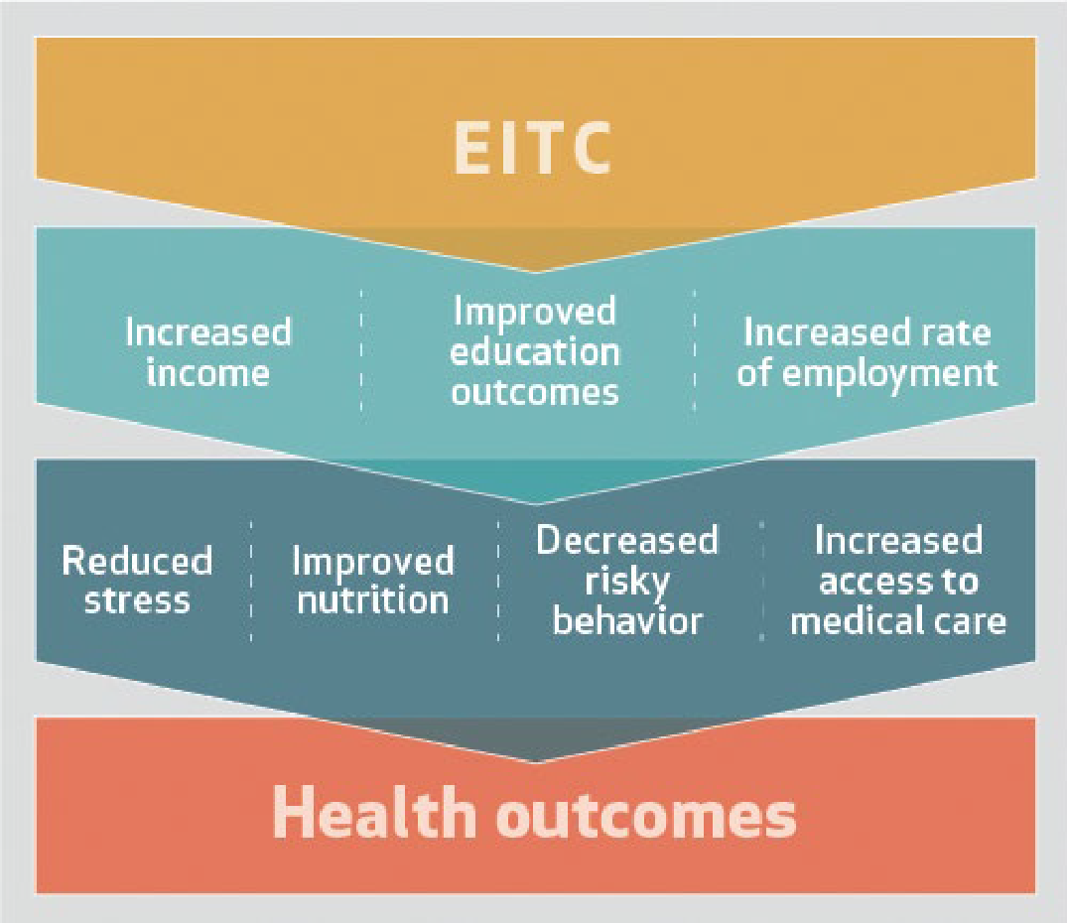
Support and Nurture Families
Scale up economic assistance programs - Earned Income Tax Credit, SNAP, housing subsidies
Implement specialized services for families in transition, such as military families
Implement parenting programs & family-centered treatment
Notes:
Supporting the basic needs of families through programs and policies like the Earned Income Tax Credit, food assistance (such as the Supplemental Nutrition Assistance Program), and housing subsidies help bolster families’ incomes to afford basic needs and have been shown to keep children out of poverty, help them achieve in school, and increase their earning power in their adult years—all of which reduces risk for substance misuse and suicide

Slide 27
Promote Positive Pathways to Educational and Life Success
Increase investments to promote positive school climates – ED, CDC DASH & STRYVE, SAMSHA Project Aware, anti-bullying, positive discipline approaches, trauma-informed
Adopt less punitive approaches in juvenile justice to treat behavioral health issues
Notes:
The Division of Adolescent and School Health (DASH) at the Centers for Disease Control and Prevention (CDC) provides funding to 28 local education agencies (school districts) to build infrastructure in schools to promote safe and supportive learning environments. The DASH funding supports staff who implement evidence-based programs in schools, including: l Professional development on classroom management (e.g., how to reinforce positive behaviors through praise and how to establish rules, routines, and expectations) to foster calm and predictable classroom environments that support academic learning and reduce opportunities for bullying or other disruptive behaviors; l Mentoring, service learning, and/or other positive youth development programs for students in the school or community; l Student-led clubs to support LGBT youth (often known as gay-straight alliances or genders and sexualities alliances) that create a safe space for students to socialize, support each other, and connect with supportive school staff; and l Providing parents and families with resources that support positive parenting practices such as open, honest communication and parental supervision. School districts that received funding and more thoroughly implemented school-connectedness activities in middle schools and high schools saw significant declines in high risk substance use, mental health issues, and suicide among students.

Slide 28
Create Community Environments that Promote Mental and Physical Health
Improve built environment and access to recreational activities
School safety efforts should include strategies that invest in safe and supportive school environments
Combat racism – investment in areas most impacted, eliminate discriminatory education practices, implement implicit bias training
Increase gay-straight alliances
Notes:
As recommended in the Final Report of the Federal Commission on School Safety (2018), the federal government should scale up strategies to prevent school violence, including through character education, the creation of a positive school climate, and mental health promotion and treatment.

Slide 29
Build Infrastructure to Align Work Across Sectors
Incentivize strategies that address common risk/protective factors across sectors – mentoring, social emotional learning
Leverage cross-agency coordinating bodies
Develop multi-sector, multi-agency evidence registry
Promote braiding and blending
of funding streams to address
“wrong pocket” problem
Notes:
Recognizing that positive school climates cannot be achieved by any one agency alone, the U.S. Department of Education, the U.S. Department of Health and Human Services, and the U.S. Department of Justice worked together to design three grant programs that, together, would provide support to professionals across disciplines to provide the instruction, counseling, and mental health services that contribute to positive school climates (School Climate Transformation Grant program, Project AWARE, and Keep Kids in School and Out of Court).
A study showed that the majority of state and local grantees were coordinating through joint training, coordinated planning, communication, and the development of shared organizational structures. As a result, local efforts were better integrated and aligned with the MTSS framework, and, ultimately, grantees were better able to meet students’ needs. The expectation of coordination communicated by the federal agencies was a key factor in encouraging grantee collaboration

Slide 30
Increase Funding for Prevention
Increase federal investments in substance misuse and suicide prevention programming (vs. treatment and recovery)
Increase investment in Garret Lee Smith Suicide Prevention program, CDC Injury Center, Drug-Free Communities, SAPT block grants
Increase funding for National Suicide Prevention Lifeline
Notes:
In fiscal year 2016, for example, of the $11.3 billion the federal government collectively spent on adolescent substance use prevention, treatment and recovery services, and research, only $1.5 billion supported prevention services and research—with significant gaps in prevention services for certain high-risk populations, like AI/AN or LGBT youth
One of the reasons for this underinvestment in universal primary prevention is the prevention paradox— the fact that the majority of cases of a disease or outcome come from low risk individuals, while only a minority come from high-risk individuals

Slide 31
For more information, contact
Rhea Farberman rfarberman@tfah.org
202-223-9870

